Slide 1
BIG DATA TECHNOLOGY FINAL PROJECT
CRYPTO CURRENCY MARKET
PROFESSOR: Mrudula Mukadam
BY: AMANUEL GEBREENDRIAS

Slide 2
Get real time data analysis of Crypto Currency for investors.
Technology used:
Apache Kafka
Spark Streaming
Hive
Tableau

Slide 3
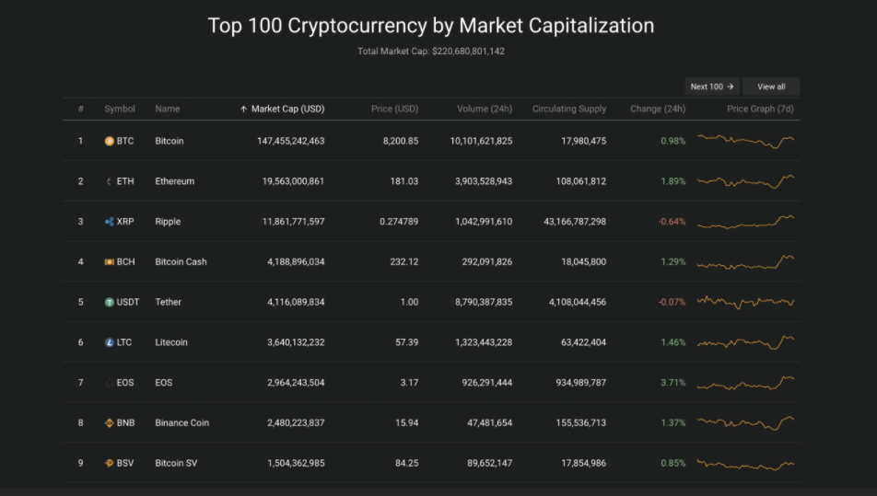
DATA SET

Slide 4
DATA FLOW DIAGRAM
Coin Gecko
Crypto Currency
API
Kafka Producer
Spark Streaming Project
(Kafka Customer)
Tableau
Hive

Slide 5
Coin Gecko Crypto Currency data source API
Why I selected this source?
How it works?
How I used the API : part of the code with some explanation.

Slide 6
What is Apache Kafka?
Kafka is a distributed streaming platform that publish and subscribe to streams of records, similar to a message queue or enterprise messaging system. It stores streams of records in a fault-tolerant durable way and process streams of records as they occur. In this project, Kafka is used to receive the streams of data from twitter and forwards it to the Spark Streaming.

Slide 7
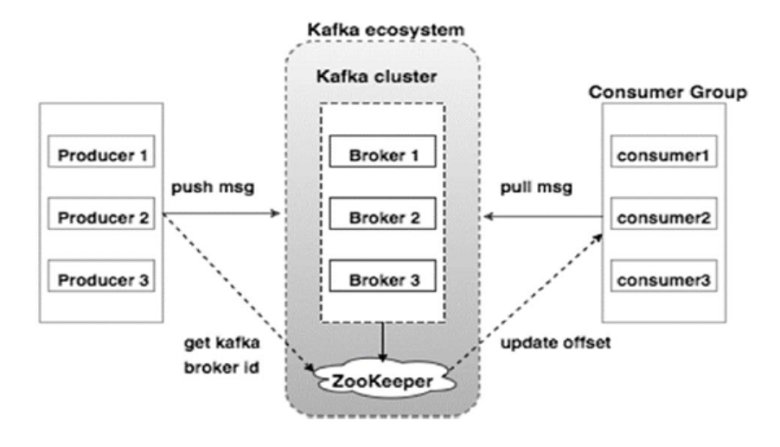
Apache Kafka Architecture?

Slide 8
What is Tableau?
Tableau is a powerful tool that can connect to different data sources and combine data together to show the relations and hidden figures.
Tableau is very easy to use for businesspeople for better data presentation and visualization.
Yield alternatives incorporate numerous graph organizes just as mapping ability. That implies creators can make shading coded maps that grandstand topographically significant information in an arrangement that is a lot simpler to process than a table or diagram would ever be.

Slide 9
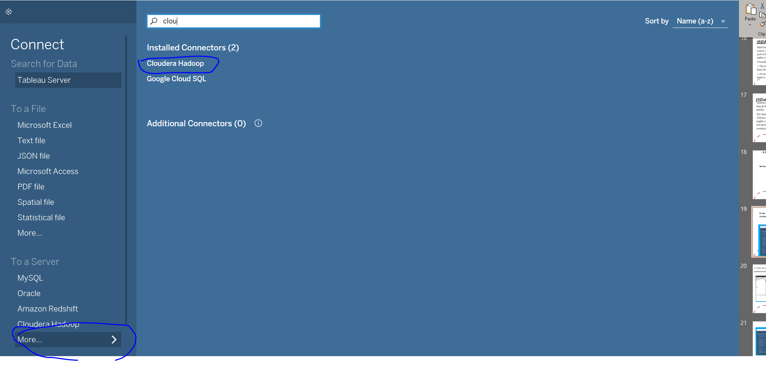
Connecting hive through Tableau
Download Tableau and Hive ODBC driver

Slide 10
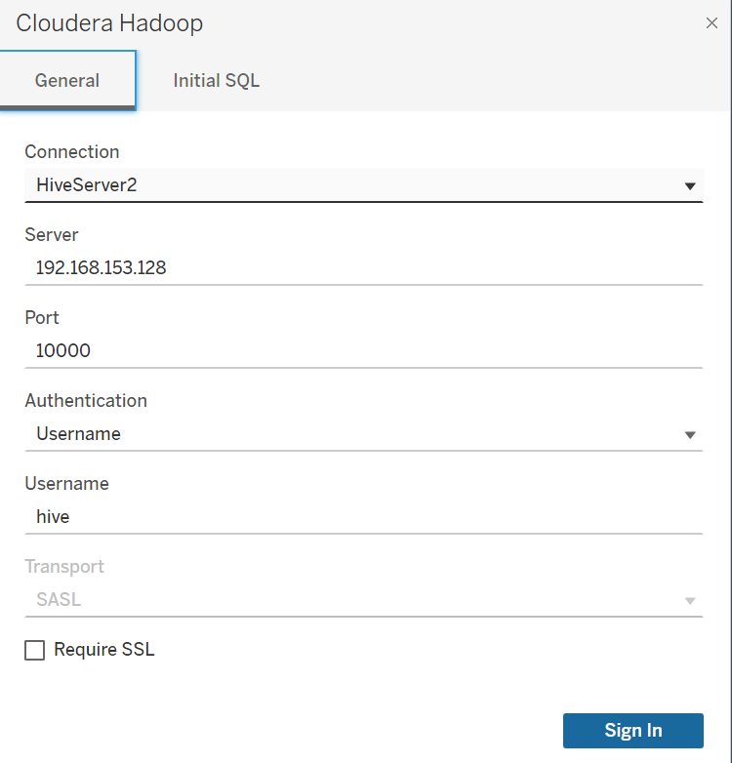
CONTI…
Use the server name/IP address and the user with the correct authentication type to connects to the server.

Slide 11
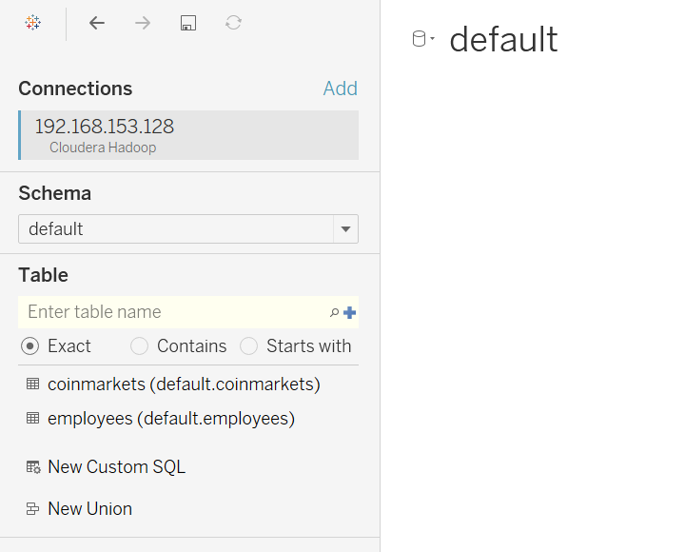
Conti….
Search for the database and then the required tables:

Slide 12
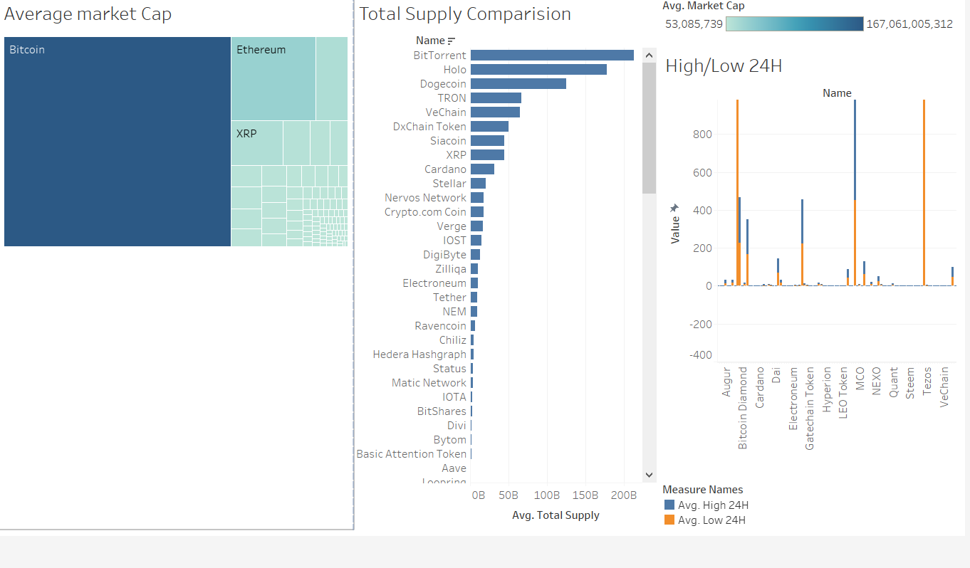
Selected queries to present some helpful information:
Tableau

